Slide 1
CLASSES
Dr. Sreekanth R
Professor

Slide 2
The class is at the core of Java
it defines the shape and nature of an object
Any concept you wish to implement in a Java program must be encapsulated within a class.

Slide 3
The General Form of a Class
A class is declared by use of the class keyword

Slide 5
When you compile this program, you will find that two .class files have been created, one for Box and one for BoxDemo. The Java compiler automatically puts each class into its own .class file.

Slide 7
Declaring Objects

Slide 8
A Closer Look at new
the new operator dynamically allocates memory for an object.

Slide 9
Introducing Methods
This is the general form of a method:
type name(parameter-list) {
// body of method
}

Slide 12
Constructors
Java allows objects to initialize themselves when they are created.
This automatic initialization is performed through the use of a constructor.

Slide 14
Parameterized Constructors
Constructors with parameters

Slide 16
The this Keyword
Sometimes a method will need to refer to the object that invoked it.
To allow this, Java defines the this keyword. this can be used inside any method to refer to the current object.
That is, this is always a reference to the object on which the method was invoked.

Slide 18
Garbage Collection
Since objects are dynamically allocated by using the new operator,
how such objects are destroyed and their memory released for later reallocation.
In some languages, such as traditional C++, dynamically allocated objects must be manually released by use of a delete operator.

Slide 19
Java takes a different approach; it handles deallocation for you automatically.
The technique that accomplishes this is called garbage collection.

Slide 20
It works like this:
when no references to an object exist, that object is assumed to be no longer needed, and the memory occupied by the object can be reclaimed.
There is no need to explicitly destroy objects. Garbage collection only occurs sporadically (if at all) during the execution of your program. It will not occur simply

Slide 21
Overloading Methods
In Java, it is possible to define two or more methods within the same class that share the same name, as long as their parameter declarations are different.

Slide 24
Overloading Constructors

Slide 27
Introducing Access Control
Java’s access modifiers are public, private, and protected. Java also defines a default access level. protected applies only when inheritance is involved.

Slide 30
Introducing final
A field can be declared as final. Doing so prevents its contents from being modified, making it, essentially, a constant.
This means that you must initialize a final field when it is declared. You can do this in one of two ways:
First, you can give it a value when it is declared.
Second, you can assign it a value within a constructor

Slide 31
final int FILE_NEW = 1;
final int FILE_OPEN = 2;
final int FILE_SAVE = 3;
final int FILE_SAVEAS = 4;
final int FILE_QUIT = 5;

Slide 32
Inheritance Basics
To inherit a class, you simply incorporate the definition of one class into another by using the extends keyword.

Slide 36
Member Access and Inheritance
Although a subclass includes all of the members of its superclass, it cannot access those members of the superclass that have been declared as private

Slide 38
Using super
Whenever a subclass needs to refer to its immediate superclass, it can do so by use of the keyword super

Slide 40
Multilevel Hierarchy
For example, given three classes called A, B, and C, C can be a subclass of B, which is a subclass of A.
When this type of situation occurs, each subclass inherits all of the traits found in all of its superclasses.
In this case, C inherits all aspects of B and A.

Slide 41
Method Overriding & Dynamic Method Dispatch
Overriding is when a child class has its method implementation for the method already present in the parent class.
One of the ways that Java manages Run Time Polymorphism is by method overriding.
Dynamic method dispatch is the mechanism by which a call to an overridden method is resolved at run time

Slide 42
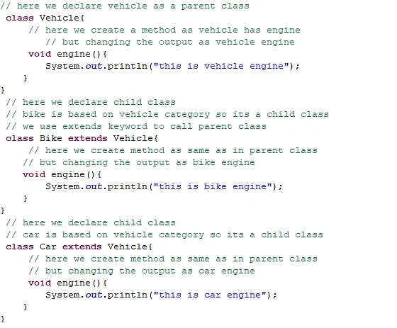

Slide 43
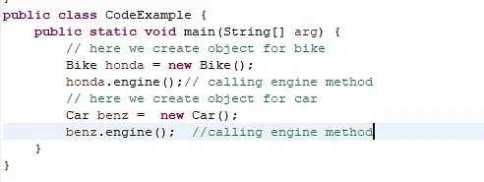

Slide 44
Using Abstract Classes
There are situations in which you will want to define a superclass that declares the structure of a given abstraction without providing a complete implementation of every method.

